Slide 1
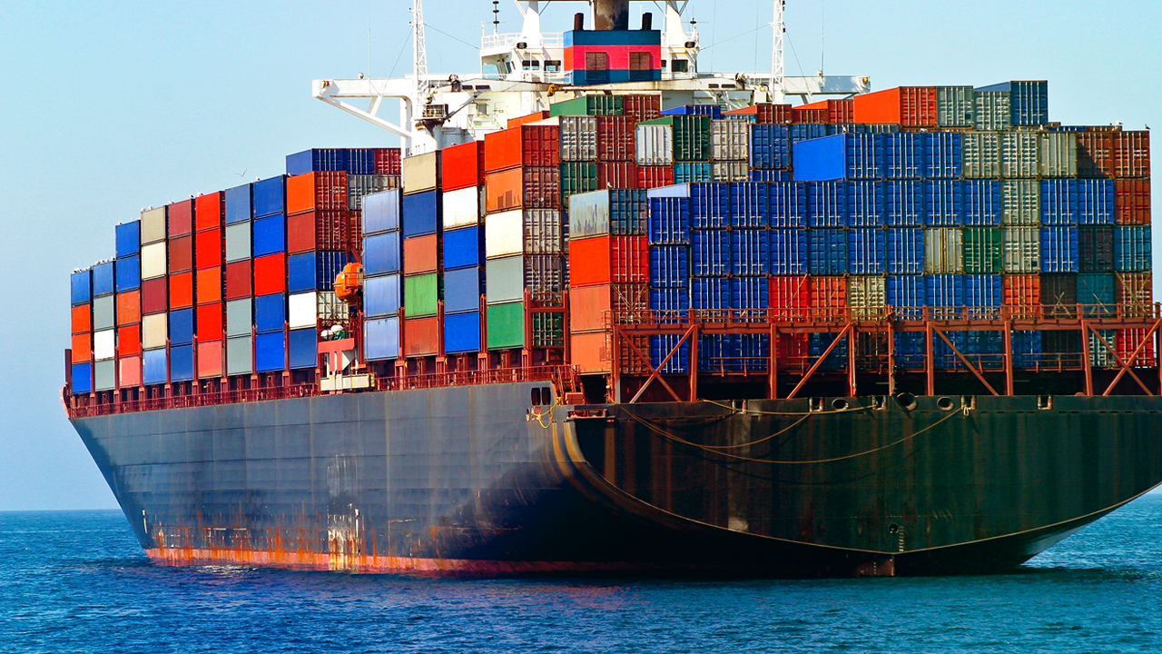
Containerization & Documentation
SoftUni Team
Technical Trainers
Software University
https://softuni.bg

Slide 2
Table of Contents
Containerization
Introduction to Docker
Docker in Action
Create Our Own Images
Documentation
Swagger 3

Slide 3
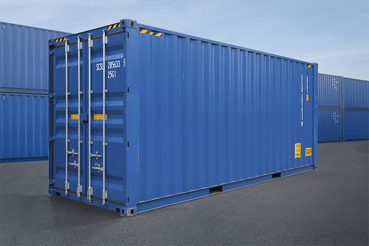
Containers and Docker
Past. Present. Future

Slide 4
Containerization
"
OS-level virtualization refers to an operating system paradigm in which the kernel allows the existence of multiple isolated user space instances known as containers, zones, jails, …
"
https://en.wikipedia.org/wiki/OS-level_virtualization

Slide 5
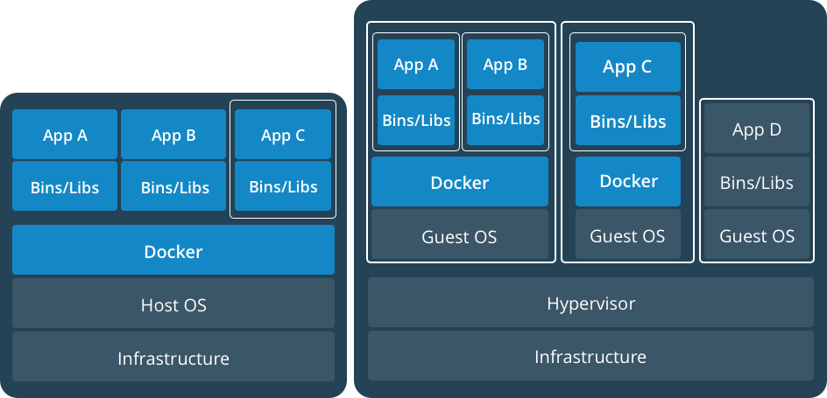
VMs and Containers
https://www.docker.com/what-container

Slide 6
Solutions
rkt by CoreOS
Application container engine
https://coreos.com/rkt
Docker by Docker Inc
Application container engine
https://www.docker.com/

Slide 7
VMs vs Containers
VMs virtualize the hardware
Complete isolation
Complete OS installation. Requires more resources
Runs almost any OS
Containers virtualize the OS
Lightweight isolation
Shared kernel. Requires fewer resources
Runs on the same OS
…

Slide 8
Containers Concepts (Docker View)
Container image shows the state of a container, including registry or file system changes
Container OS image is the first layer of potentially many image layers that make up a container
Container repository stores container images and their dependencies

Slide 9
Definitions
Container
Containers are processes with much more isolation
Image
Images provide a way for simpler software distribution
Writable Layer
MariaDB
Layers
Ubuntu
Container

Slide 10
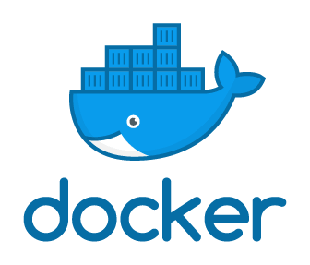
Docker
Whole New World

Slide 11
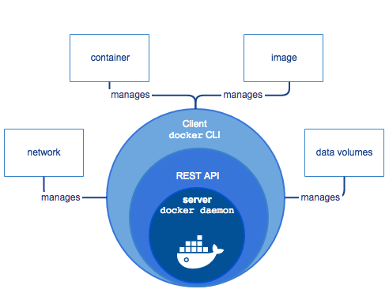
Docker Engine
Docker Mission – Build, Ship, Deploy
Client-server application
Components
dockerd daemon
REST API
docker CLI
https://docs.docker.com/engine/docker-overview

Slide 12
Registries
Provided by Docker
Cloud
Docker Hub (https://hub.docker.com/explore/)
Docker Store (https://store.docker.com/)
On-premise
Provided by 3rd parties
Quay.io, Artifactory, Google Container Registry

Slide 13
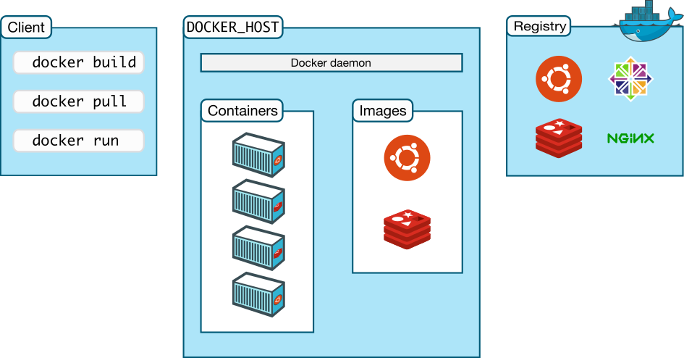
Workflow
1
3
2
https://docs.docker.com/engine/docker-overview

Slide 14

Docker Installation
Options

Slide 15
What We Need to Know?
Two Editions (Community and Enterprise)
Native Options
Docker for Linux
Docker for MAC
Docker for Windows
Docker Toolbox (deprecated) - All-in-one solution
For Mac and Windows
Deployment via package system (three channels – stable, nightly, and test), script, or archive
Specific requirements: OS version, Hypervisor, etc.

Slide 16
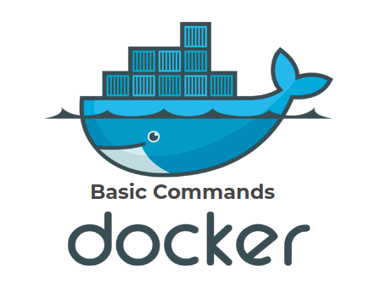
Working with Docker
Commands

Slide 17
Pull / Image Pull
Purpose
Pull an image or a repository from a registry
Old syntax
New syntax
Example
docker pull [OPTIONS] NAME[:TAG|@DIGEST]
docker image pull [OPTIONS] NAME[:TAG|@DIGEST]
docker image pull ubuntu:latest

Slide 18
Run / Container Run
Purpose
Run a command in a new container
Old syntax
New syntax
Example
docker run [OPTIONS] IMAGE [COMMAND] [ARG]
docker container run [OPTIONS] IMAGE [COMMAND] [ARG]
docker container run -it ubuntu

Slide 19
Images / Image Ls
Purpose
List locally available images
Old syntax
New syntax
Example
docker images [OPTIONS] [REPOSITORY[:TAG]]
docker image ls [OPTIONS] [REPOSITORY[:TAG]]
docker image ls fedora

Slide 20
Ps / Container Ls
Purpose
List containers
Old syntax
New syntax
Example
docker ps [OPTIONS]
docker container ls [OPTIONS]
docker container ls –a -q

Slide 21
Rm / Container Rm
Purpose
Remove one or more containers
Old syntax
New syntax
Example
docker rm [OPTIONS] CONTAINER [CONTAINER]
docker container rm [OPTIONS] CONTAINER [CONTAINER]
docker container rm weezy_snake

Slide 22
Rmi / Image Rm
Purpose
Remove one or more images
Old syntax
New syntax
Example
docker rmi [OPTIONS] IMAGE [IMAGE]
docker image rm [OPTIONS] IMAGE [IMAGE]
docker image rm ubuntu fedora

Slide 23
Start / Container Start
Purpose
Start one or more stopped containers
Old syntax
New syntax
Example
docker start [OPTIONS] CONTAINER [CONTAINER]
docker container start [OPTIONS] CONTAINER [CONTAINER]
docker container start -a -i 0cbf27183

Slide 24
Restart / Container Restart
Purpose
Restart a one or more containers
Old syntax
New syntax
Example
docker restart [OPTIONS] CONTAINER [CONTAINER]
docker container restart [OPTIONS] CONTAINER [CONTAINER]
docker container restart 0cbf27183

Slide 25
Stop / Container Stop
Purpose
Stop one or more running containers
Old syntax
New syntax
Example
docker stop [OPTIONS] CONTAINER [CONTAINER]
docker container stop [OPTIONS] CONTAINER [CONTAINER]
docker container stop 0cbf27183

Slide 26
Unpause / Container Unpause
Purpose
Unpause all processes within one or more containers
Old syntax
New syntax
Example
docker unpause CONTAINER [CONTAINER]
docker container unpause CONTAINER [CONTAINER]
docker container unpause 0cbf27183

Slide 27
Attach / Container Attach
Purpose
Attach to a running container
Old syntax
New syntax
Example
docker attach [OPTIONS] CONTAINER
docker container attach [OPTIONS] CONTAINER
docker container attach 0cbf27183

Slide 28
Push / Image Push
Purpose
Push an image or repository to a registry
Old syntax
New syntax
Example
docker push [OPTIONS] NAME[:TAG]
docker image push [OPTIONS] NAME[:TAG]
docker image push repo-name/test:latest

Slide 29
Login
Purpose
Log into a Docker registry
Old syntax
New syntax
Example
docker login [OPTIONS] [SERVER]
# same
docker login

Slide 30
Logout
Purpose
Log out from a Docker registry
Old syntax
New syntax
Example
docker logout [SERVER]
# same
docker logout

Slide 31
Image from File
General Structure and Common Fields

Slide 32
General Structure (Dockerfile)
Script, composed of commands and arguments
Always begins with FROM instruction
Comment
# Set the base image
FROM nginx
# Set the maintainer
MAINTAINER John Smith
# Copy files
COPY index.html /usr/share/nginx/html/
Command
(Instruction)

Slide 33
FROM
Purpose
Defines the base image to use to start the build process
Syntax
Example
FROM <image>[:<tag>] [AS <name>]
# it is a good practice to state a version (tag)
FROM ubuntu:18.04
# for the latest version the tag could be skipped
FROM ubuntu

Slide 34
MAINTAINER
Purpose
Sets the author field of the image. It is deprecated
Syntax
Example
MAINTAINER <name>
# deprecated
MAINTAINER John Smith
# newer variant is this:
LABEL maintainer="John Smith"

Slide 35
RUN
Purpose
Used during build process to add software (forms another layer)
Syntax
Example
RUN <command>
# single command
RUN apt-get -y update
# more than one command
RUN apt-get -y update && apt-get -y upgrade

Slide 36
COPY
Purpose
Copy files between the host and the container
Syntax
Example
COPY [--chown=<user>:<group>] <src>... <dest>
# Copy single file
COPY readme.txt /root
# Copy multiple files
COPY *.html /var/www/html/my-web-app

Slide 37
ADD
Purpose
Copy files to the image
Syntax
Example
ADD [--chown=<user>:<group>] <src>... <dest>
# Add single file from URL
ADD https://softuni.bg/favicon.ico /www/favicon.ico
# Add tar file content
ADD web-app.tar /var/www/html/my-web-app

Slide 38
EXPOSE
Purpose
Informs Docker that the container listens on the specified ports
Syntax
Example
EXPOSE <port> [<port>/<protocol>...]
# single port
EXPOSE 80
# multiple ports
EXPOSE 80 8080

Slide 39
ENTRYPOINT
Purpose
Allows configuration of container that will run as an executable
Syntax
# exec form, this is the preferred form
ENTRYPOINT ["executable", "param1", "param2"]
# shell form
ENTRYPOINT command param1 param2

Slide 40
CMD
Purpose
Main purpose is to provide defaults for an executing container
Syntax
# exec form, this is the preferred form
CMD ["executable","param1","param2"]
# as default parameters to ENTRYPOINT
CMD ["param1","param2"]
# shell form
CMD command param1 param2

Slide 41
CMD vs ENTRYPOINT
Both define what command gets executed when running a container
Dockerfile should specify at least one of them
ENTRYPOINT should be defined when using the container as an executable
CMD should be used as a way of defining default arguments for an ENTRYPOINT command or for executing an ad-hoc command in a container
CMD will be overridden when running the container with alternative arguments

Slide 42
CMD vs ENTRYPOINT
Both have exec and shell form
When used together always use their exec form
 |  | ENTRYPOINT
 |  | N/A | exec_entry p1_entry | [“exec_entry”, “p1_entry”]
CMD | N/A | Error | /bin/sh -c exec_entry p1_entry | exec_entry p1_entry
 | [“exec_cmd”, “p1_cmd”] | exec_cmd p1_cmd | /bin/sh -c exec_entry p1_entry | exec_entry p1_entry exec_cmd p1_cmd
 | [“p1_cmd”, “p2_cmd”] | p1_cmd p2_cmd | /bin/sh -c exec_entry p1_entry | exec_entry p1_entry p1_cmd p2_cmd
 | exec_cmd p1_cmd | /bin/sh -c exec_cmd p1_cmd | /bin/sh -c exec_entry p1_entry | exec_entry p1_entry /bin/sh -c exec_cmd p1_cmd
https://docs.docker.com/engine/reference/builder/#understand-how-cmd-and-entrypoint-interact

Slide 43
Build / Image Build
Purpose
Build an image from a Dockerfile
Old syntax
New syntax
Example
docker build [OPTIONS] PATH | URL | -
docker image build [OPTIONS] PATH | URL | -
docker image build -t new-image .

Slide 44
Recommendations
Don’t create large images
Don’t use only the “latest” tag
Don’t run more than one process in a single container
Don’t rely on IP addresses
Put information about the author
https://developers.redhat.com/blog/2016/02/24/10-things-to-avoid-in-docker-containers/
http://www.projectatomic.io/docs/docker-image-author-guidance/

Slide 45

Swagger 3

Slide 46
Swagger
With the Swagger we can simplifies API development for users, teams, and enterprises
Why we need documentations:
front-end and back-end components often separate a web application
usually, we expose APIs as a back-end component for the front-end component
Reference documentation should simultaneously describe every change in the API

Slide 47
SpringDoc
Spring Boot, using the SpringDoc implementation of the Swagger 3 specification.
It's enough to add a single springdoc-openapi-ui dependency:
Go to http://localhost:8080/swagger-ui/index.html to test it.
<dependency>
<groupId>org.springdoc</groupId>
<artifactId>springdoc-openapi-ui</artifactId>
<version>1.6.8</version>
</dependency>
dependencies {
implementation 'org.springdoc:springdoc-openapi-ui'
}

Slide 48
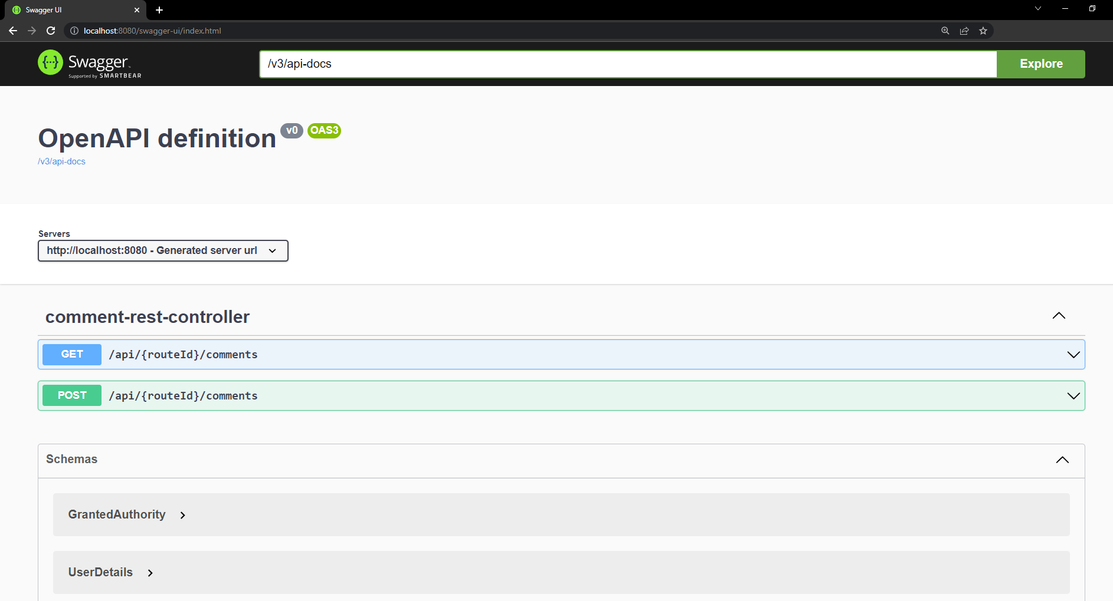
Using Swagger UI example

Slide 49
Swagger UI
Swagger UI allows anyone to visualize and interact with the API’s resources without having any of the implementation logic in place.
It’s automatically generated from your OpenAPI (formerly known as Swagger) Specification, with the visual documentation making it easy for back-end implementation and client-side consumption.

Slide 50

Summary
Containerization is a hot topic, but it isn’t something new
Docker is de-facto a standard
Images can be published to private or public registries
Using Swagger 3 for easy documenting our application
…
…
…

Slide 51
Resources
Docker Documentation
https://docs.docker.com/
Docker Hub Documentation
https://docs.docker.com/docker-hub/
Docker Registry Documentation
https://docs.docker.com/registry/
Swagger Documentation
https://swagger.io/
…
…
…

Slide 52
Questions?
Notes:
52

Slide 53












SoftUni Diamond Partners

Slide 54


Educational Partners

Slide 55

License
This course (slides, examples, demos, exercises, homework, documents, videos and other assets) is copyrighted content
Unauthorized copy, reproduction or use is illegal
© SoftUni – https://about.softuni.bg/
© Software University – https://softuni.bg
Notes:
55

Slide 56
Trainings @ Software University (SoftUni)
Software University – High-Quality Education, Profession and Job for Software Developers
softuni.bg, about.softuni.bg
Software University Foundation
softuni.foundation
Software University @ Facebook
facebook.com/SoftwareUniversity
Software University Forums
forum.softuni.bg
Notes:
56

